Slide 1
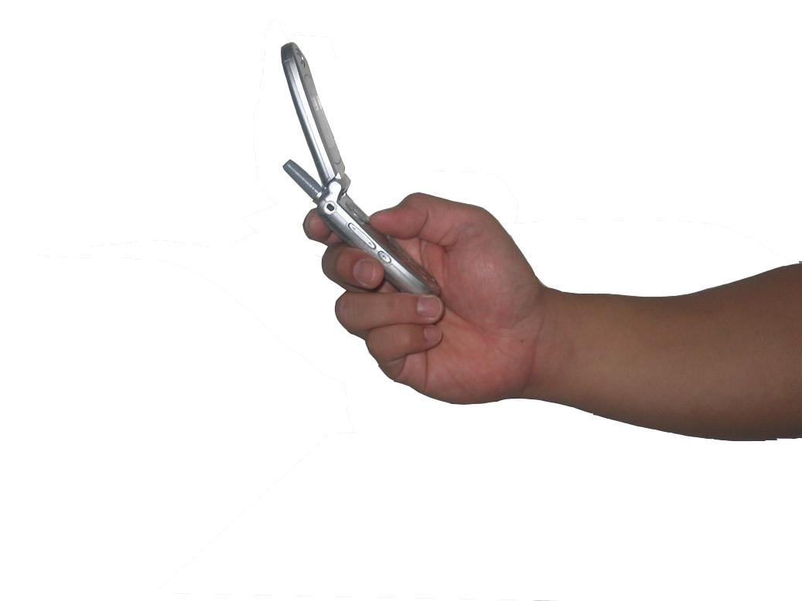
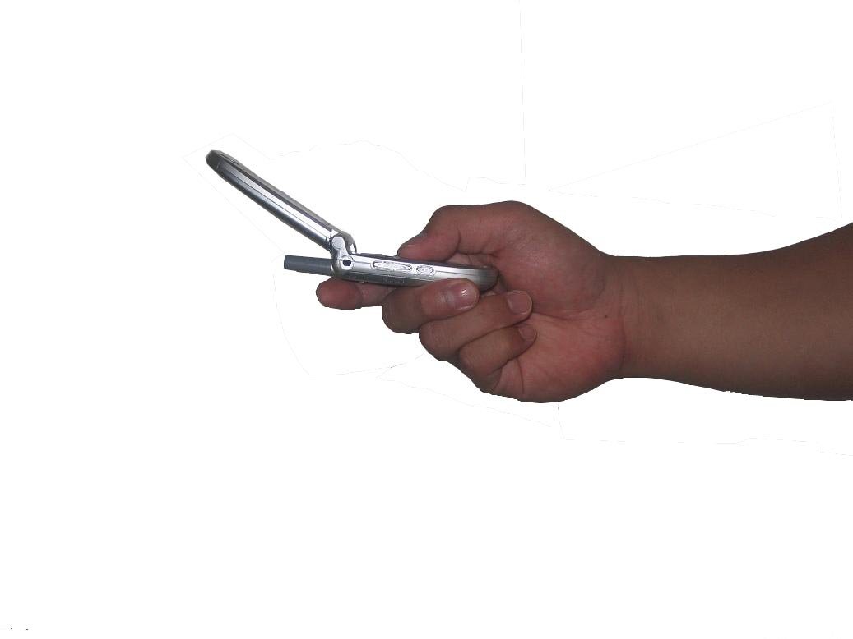
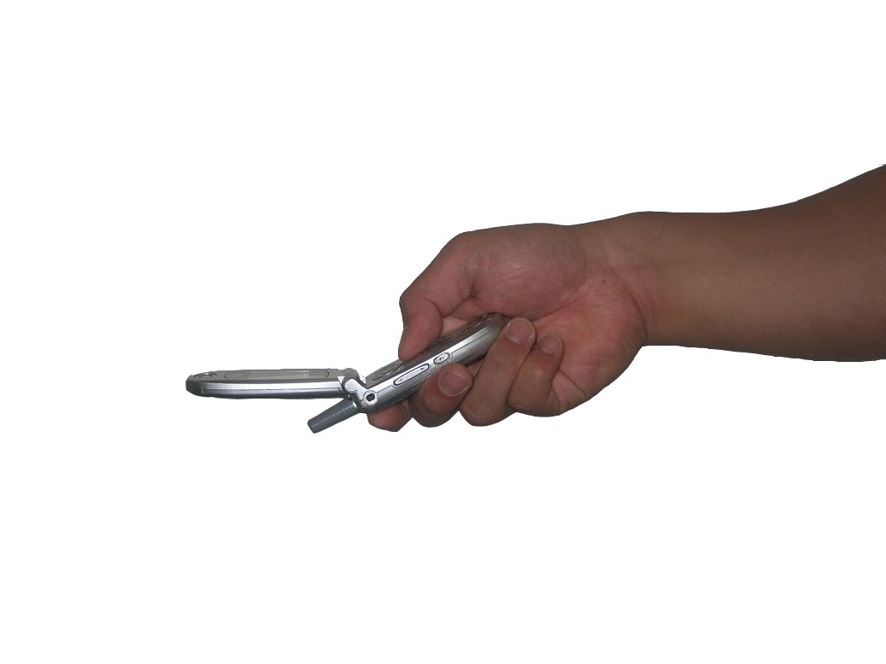
Tilt Techniques
Investigating the
of
wrist-based input
DEXTERITY
mahfuz rahman
sean gustafson
pourang irani
sriram subramanian

Slide 2
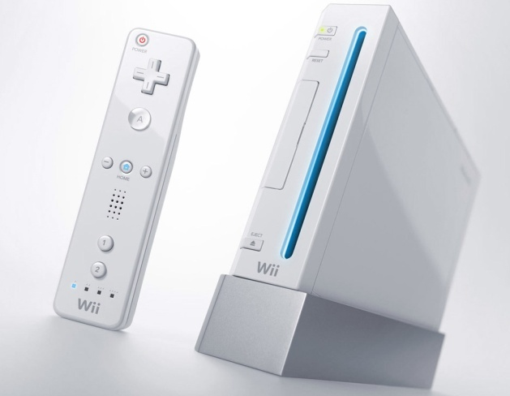
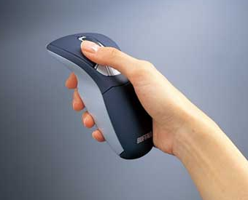
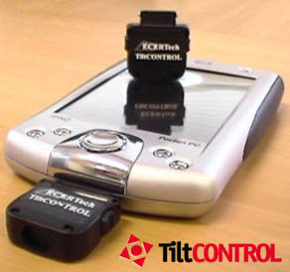


TilT-Based Interaction

Slide 3
Contributions
framework for tilt-based interaction
capabilities of each wrist axis
comparison of methods for discretizing the raw tilt sensor readings

Slide 4
RELATED WORK

Slide 5
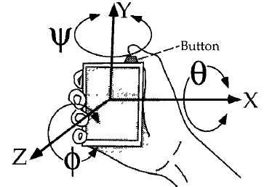
[Rekimoto UIST96]

Slide 6
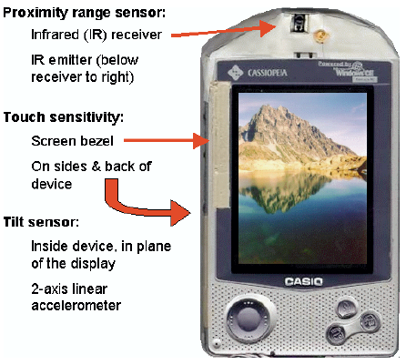
[Hinkley UIST00]

Slide 7
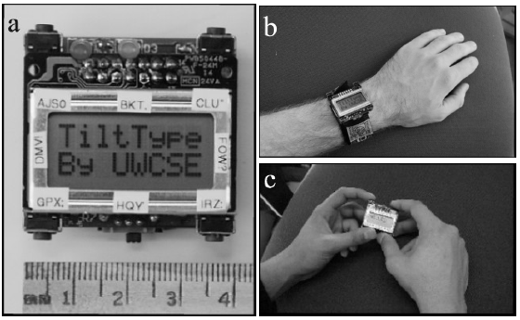
TiltType [Partridge UIST02]

Slide 8
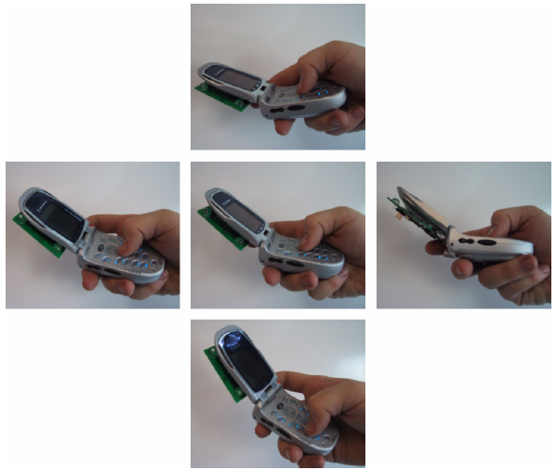
TiltText [Wigdor UIST03]

Slide 9
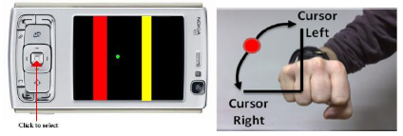
[Crossan MobileHCI08]

Slide 10
FRAMEWORK

Slide 11
Axes of wrist movement
Rate control vs. position control
Discretization of raw tilt values
Selection mechanism
Feedback

Slide 12
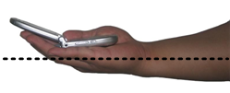
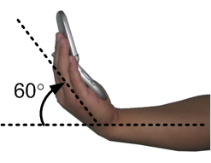
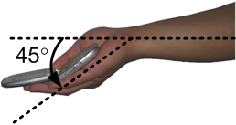
1. axes of movement
Flexion / Extension

Slide 13
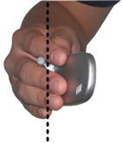
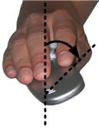
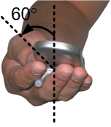
1. axes of movement
65°
Pronation / Supination

Slide 14
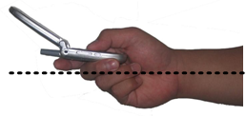
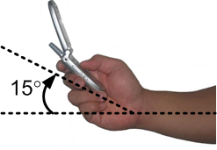
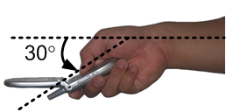
1. axes of movement
Ulnar / Radial Deviation

Slide 15
2. rate vs. position
We use position control

Slide 16
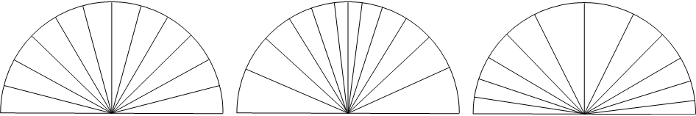
3. Discretization
Linear
Quadratic
Sigmoid
y=x²
y=1/(1+e^{-x})

Slide 17
4. selection mechanism
click-tilt-release ←
click-to-select

Slide 18
5. feedback
visual – remote or local ←
auditory
tactile

Slide 19
EXPERIMENT

Slide 20
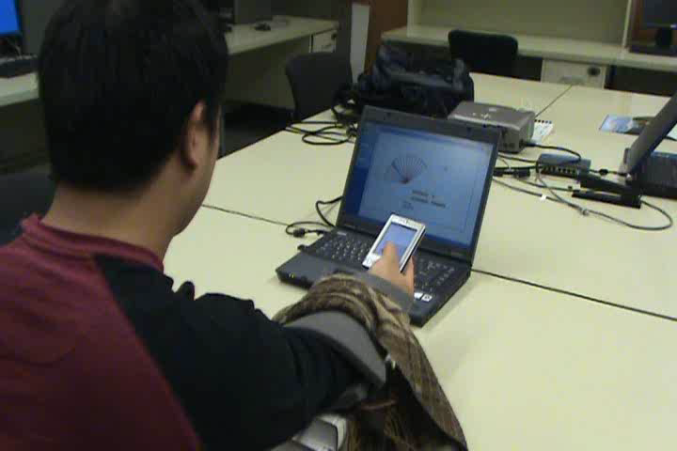
task

Slide 21
independent variables
tilt axis: flexion/extension,
pronation/supination,
ulnar/radial deviation
discretization function: linear, sigmoid, quadratic
divisions: 4, 8, 12, 16. Only 4 divisions for deviation
distance: 10%, 30%, 70%, 90% of range of motion
direction: 0° to max, max to 0°

Slide 22
dependent variables
completion time
error rate
number of crossings

Slide 23
flexion results

Slide 24
pronation results

Slide 25
Deviation Results
only with 4 levels

Slide 26
Experiment 2
Design same as experiment 1 except
Remote feedback
No sigmoid function

Slide 27
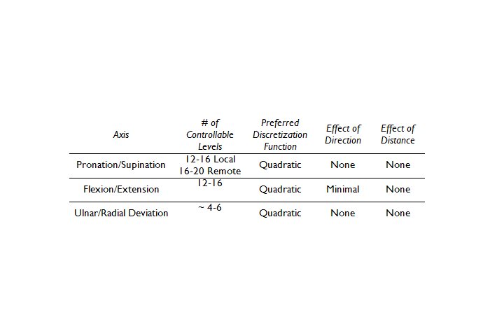
discussion

Slide 28
IMPLICATIONS
FOR DESIGN

Slide 29
design guidelines
avoid ulnar/radial deviation if possible or use only for input of a couple levels.
flexion/extension is limited to 8 levels of tilt
pronation/supination is limited to 12 levels of tilt
discretization function plays an important role

Slide 30
Tilt Text
[Wigdor UIST03]

Slide 31
Conclusion
a framework for tilt-based interaction
characterization capabilities of each wrist axis
comparison of methods for discretizing the raw tilt sensor readings

Slide 32

Thanks!
Sean Gustafson
Hasso Plattner Institute
http://www.seangustafson.com

