Slide 1
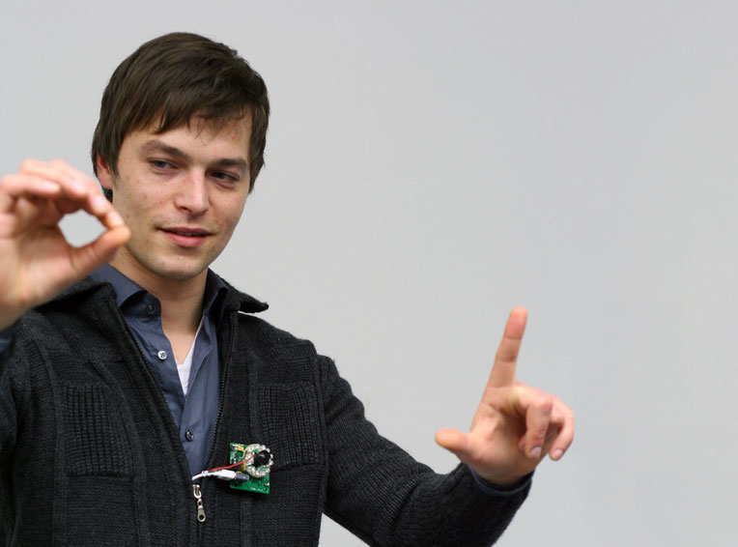

imaginary interfaces
Sean Gustafson
with
Daniel Bierwirth
Patrick Baudisch

Slide 2
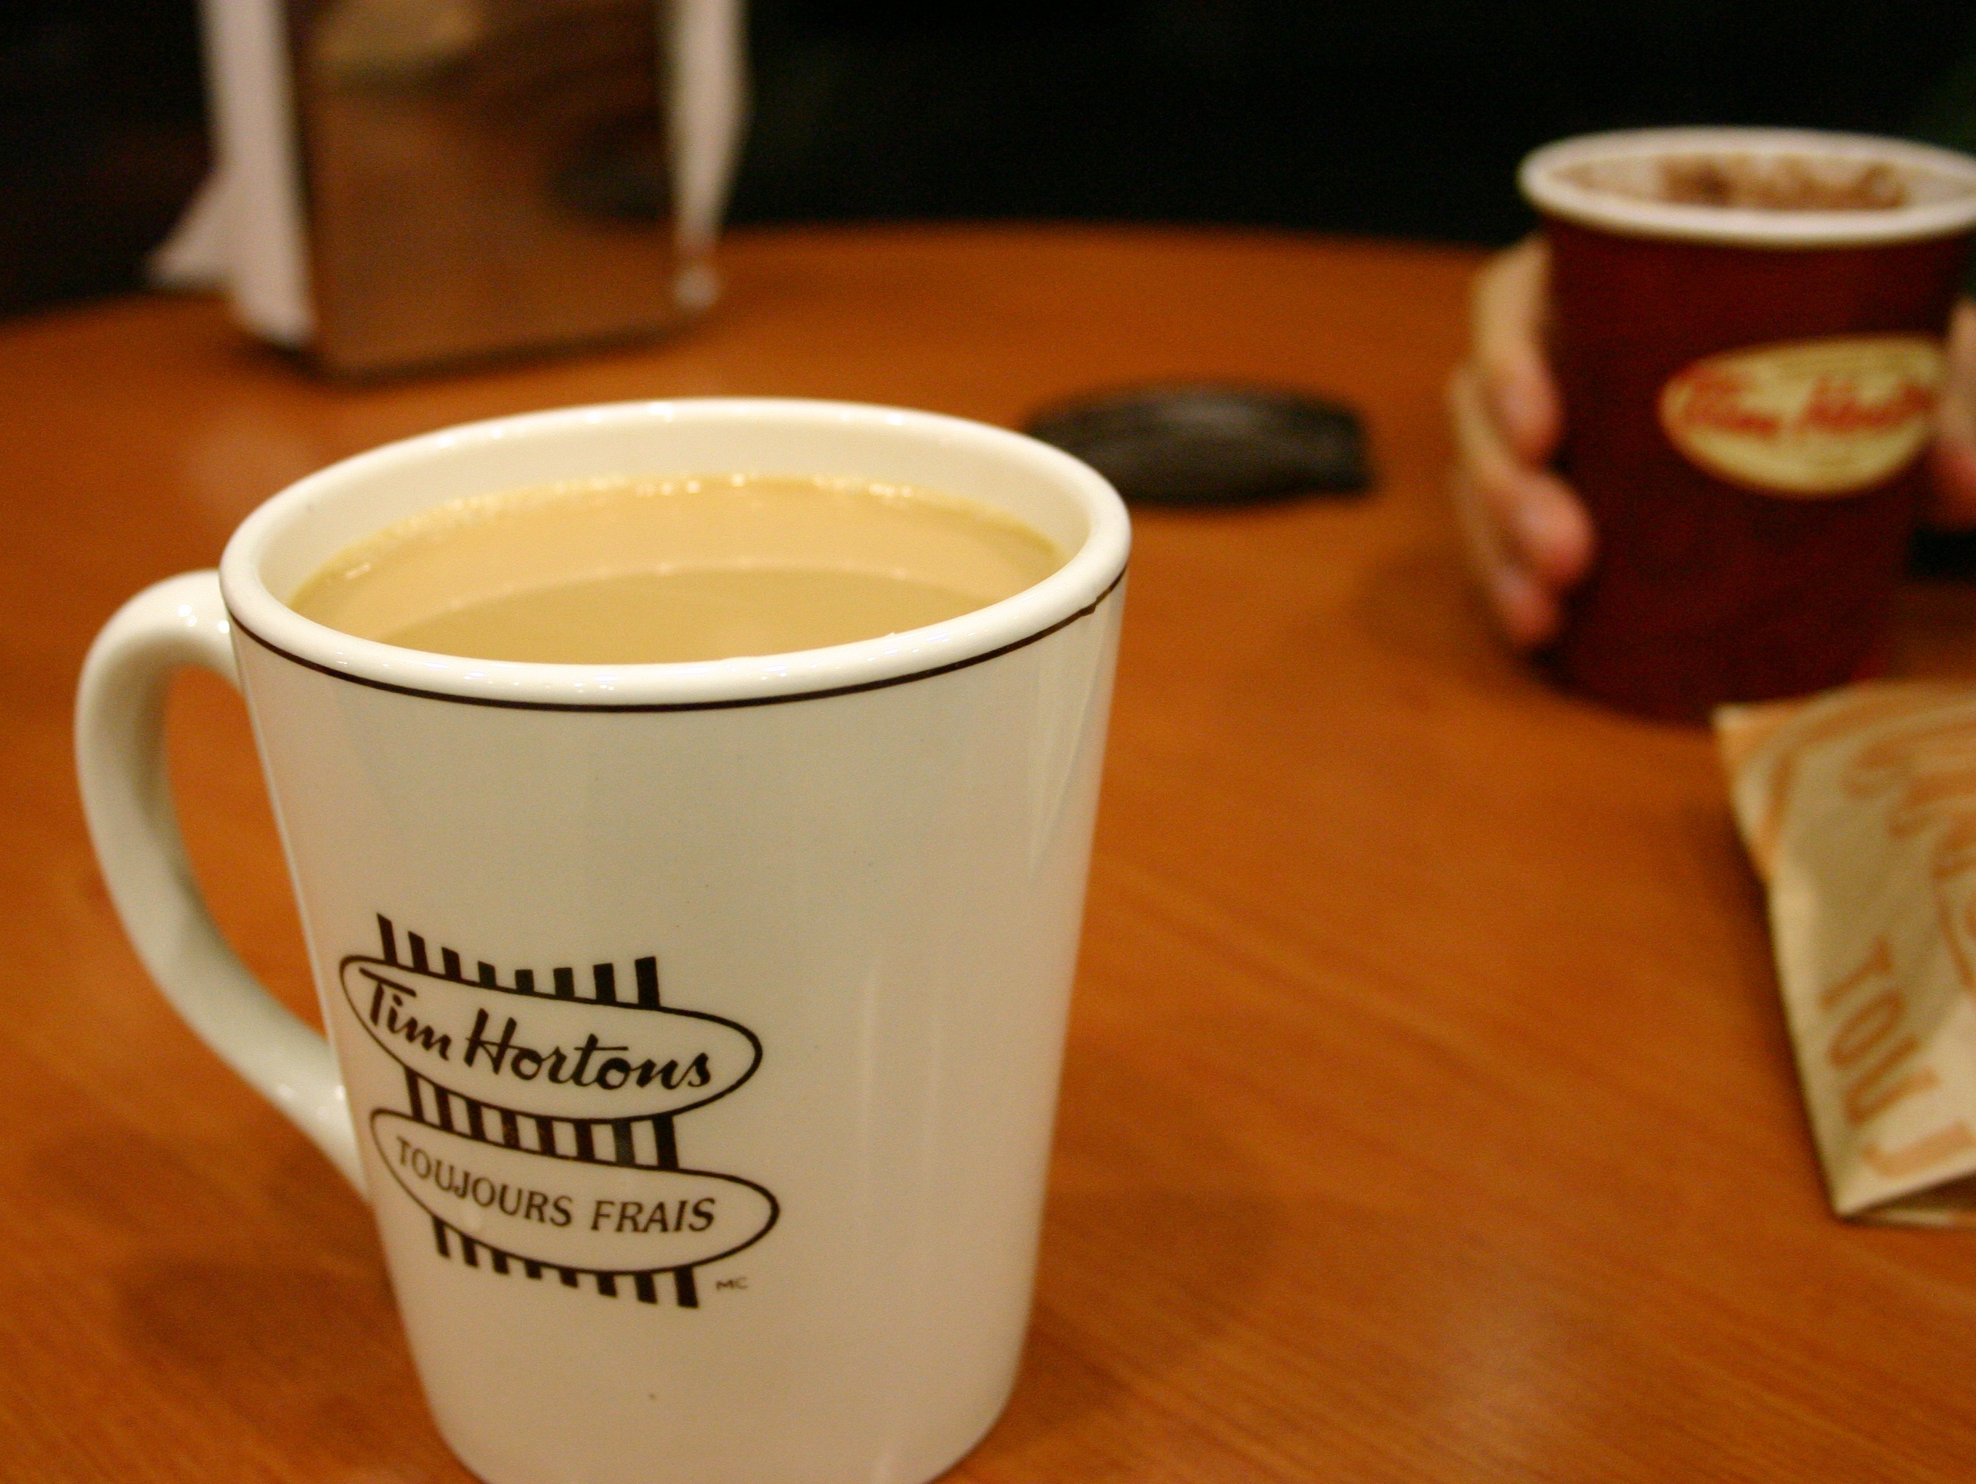
Spatial Interaction
reach for a coffee cup

Slide 3
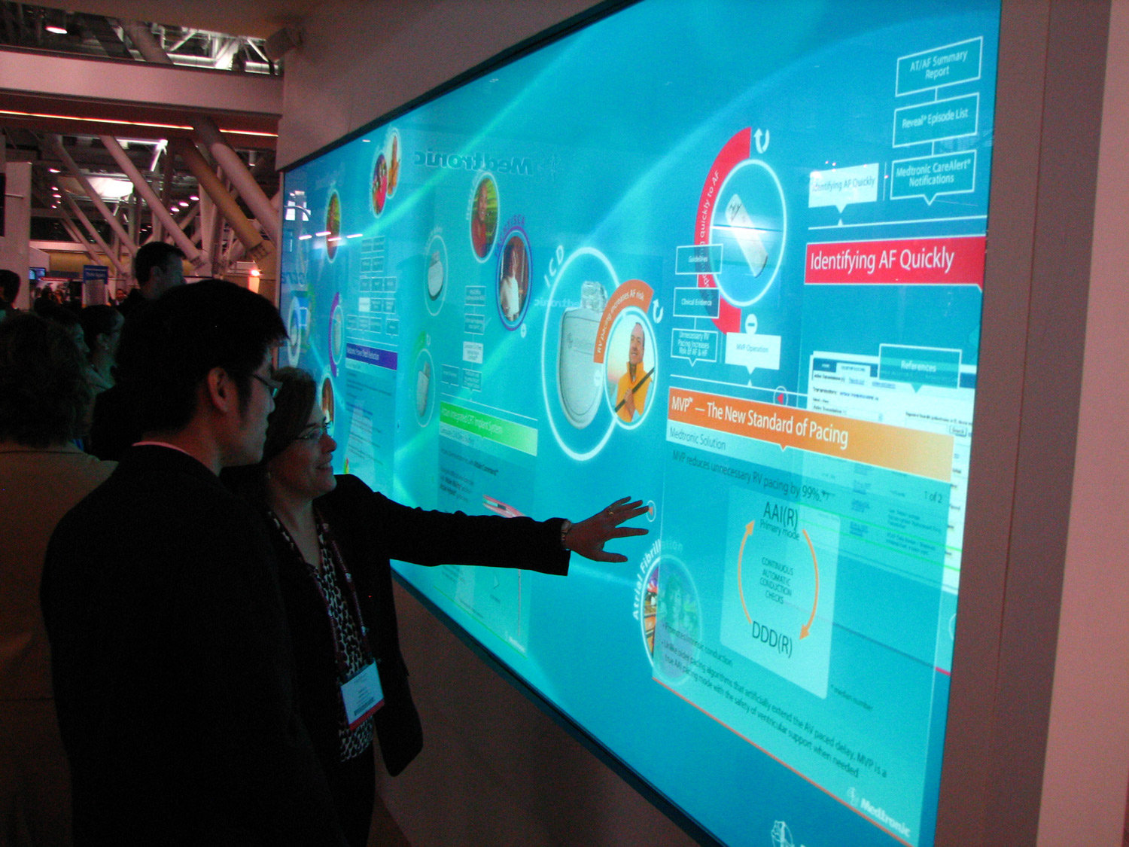
Spatial Interaction

Slide 4
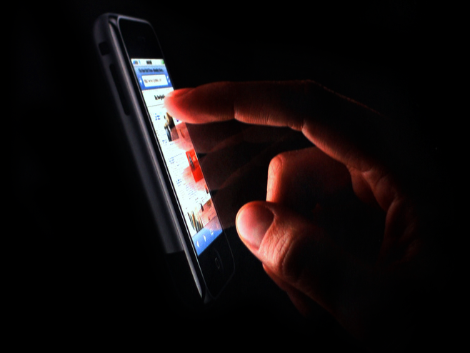
Spatial Interaction
Notes:
Touch on iphones is great, but they have to be that large. The output channel can still be shrunk – with higher density pixels and time multiplexing but the input channel cannot. My proposed solution is to…

Slide 5
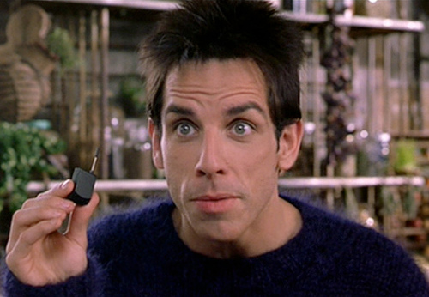
what happens when the touch area
is this small?

Slide 6
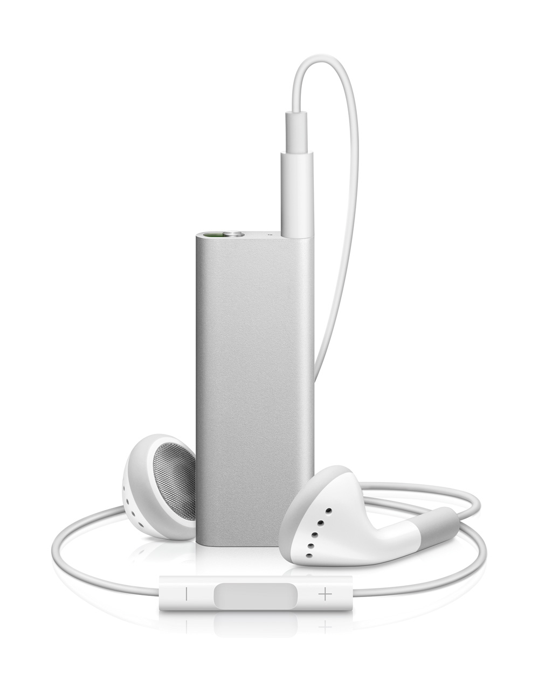
no more spatial

Slide 7
re-introduce spatial
+

Slide 8
imaginary InterfaceS

Slide 9
Interact with
“nothing”

Slide 10
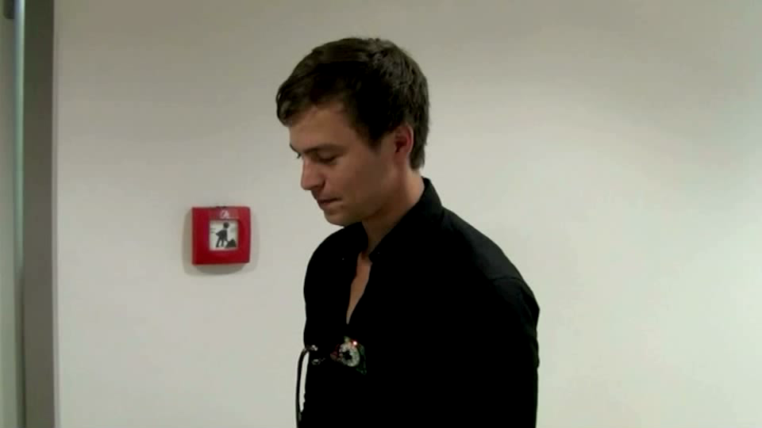
Imaginary INterfaces

Slide 11
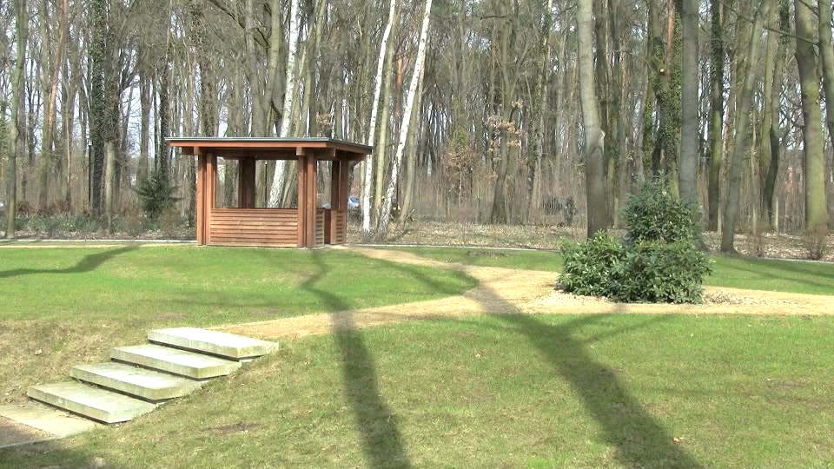
BRoker Mockup

Slide 12
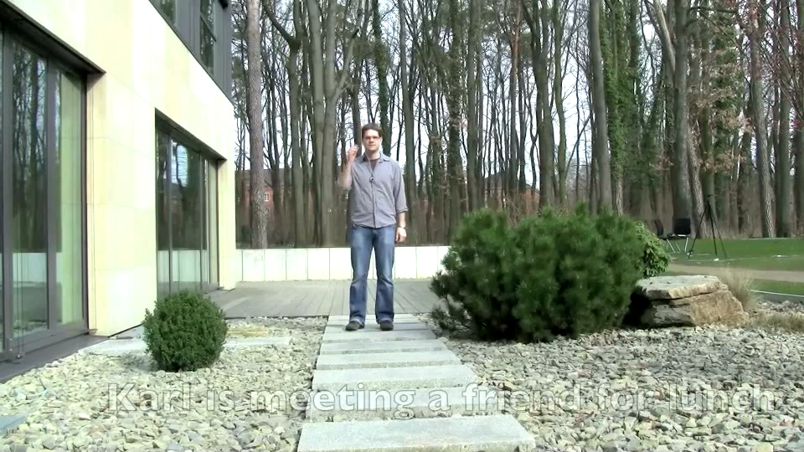
directions MOCKUP

Slide 13
to operate imaginary interfaces, users
create a drawing, then extend & annotate
draw a GUI, interact with it –or–
operate a GUI used on touch screen earlier

Slide 14
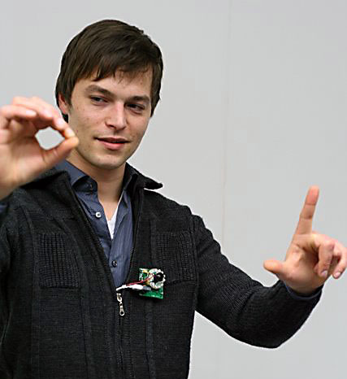
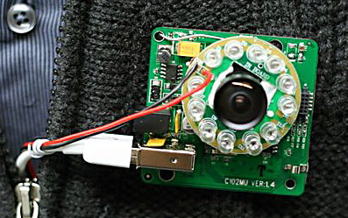
Prototype Hardware

Slide 15
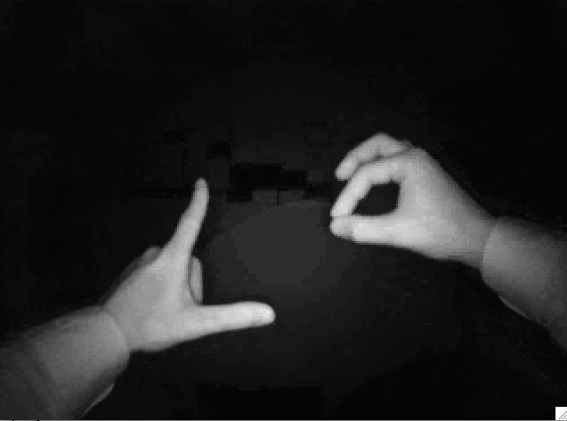
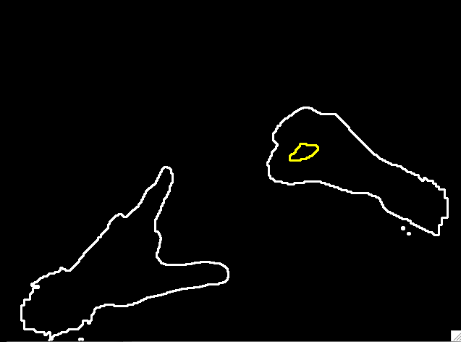
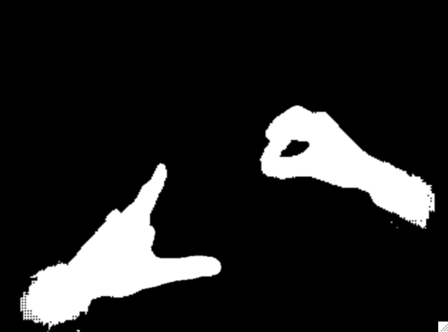
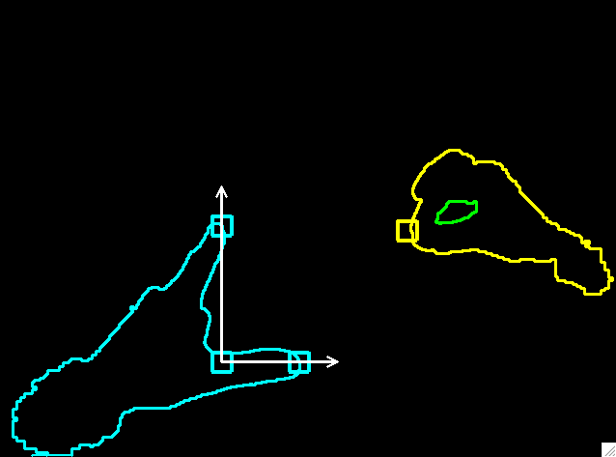
computer vision

Slide 16
future form factors

Slide 17
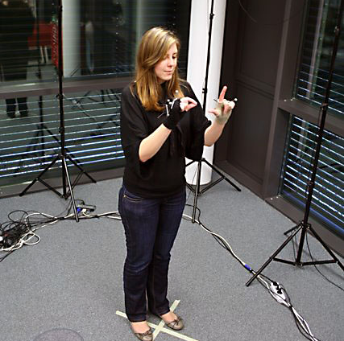
Can people use this?
the main question:
can people
interact spatially
with something they cannot see?

Slide 18
Can people use this?
when using a touch screen users go to a target they see
when using imaginary interface users need to go to a target they remember

Slide 19
Can people use this?
to operate imaginary interfaces, users
create a drawing, then extend & annotate
draw a GUI, interact with it –or–
operate a GUI used on touch screen earlier
all of these require them to revisit a location

Slide 20
Can people use this?
our main hypothesis:
users are able to revisit locations

Slide 21
(and we think it comes from
watching their own hands perform)

Slide 22
related work

Slide 23
SCREENLESS

Slide 24
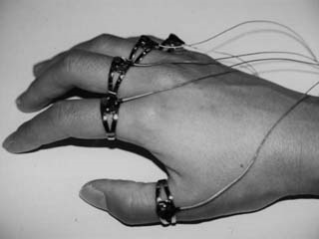
body-coupled finger ring [Fukomoto97]

Slide 25
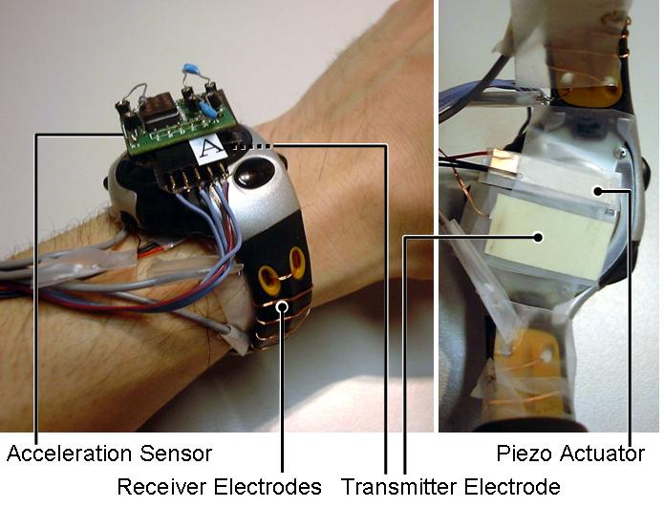
gestureWrist [Rekimoto01]

Slide 26
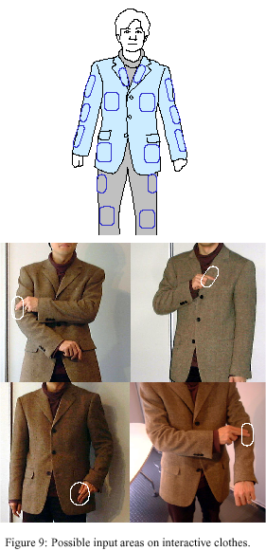
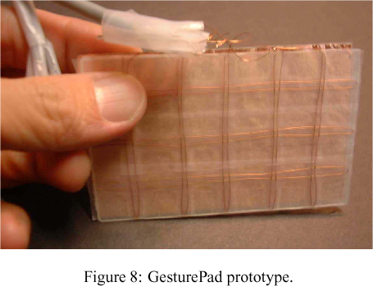
gesturePad [Rekimoto01]

Slide 27
disappearing mobile [Ni and Baudisch09]

Slide 28
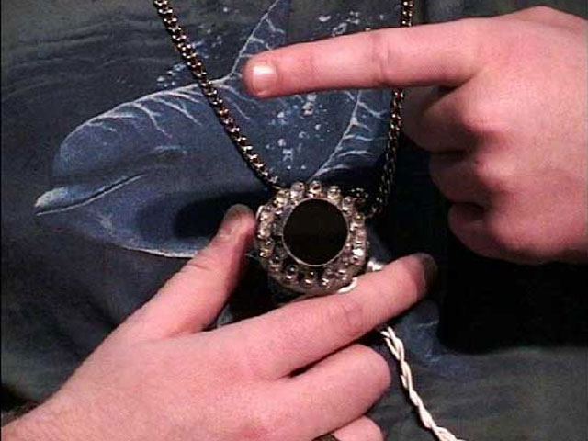
gesture pendant [Starner00]

Slide 29
SMALL SCREEN
BIGGER INPUT

Slide 30
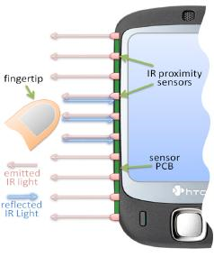
side sight [Butler08]

Slide 31
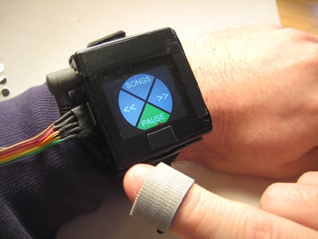
abracadabra [Harrison09]

Slide 32
hoverFlow [Kratz09]

Slide 33
peephole [Yee03]

Slide 34
PROJECTOR FOR
PORTABLE DISPLAY

Slide 35
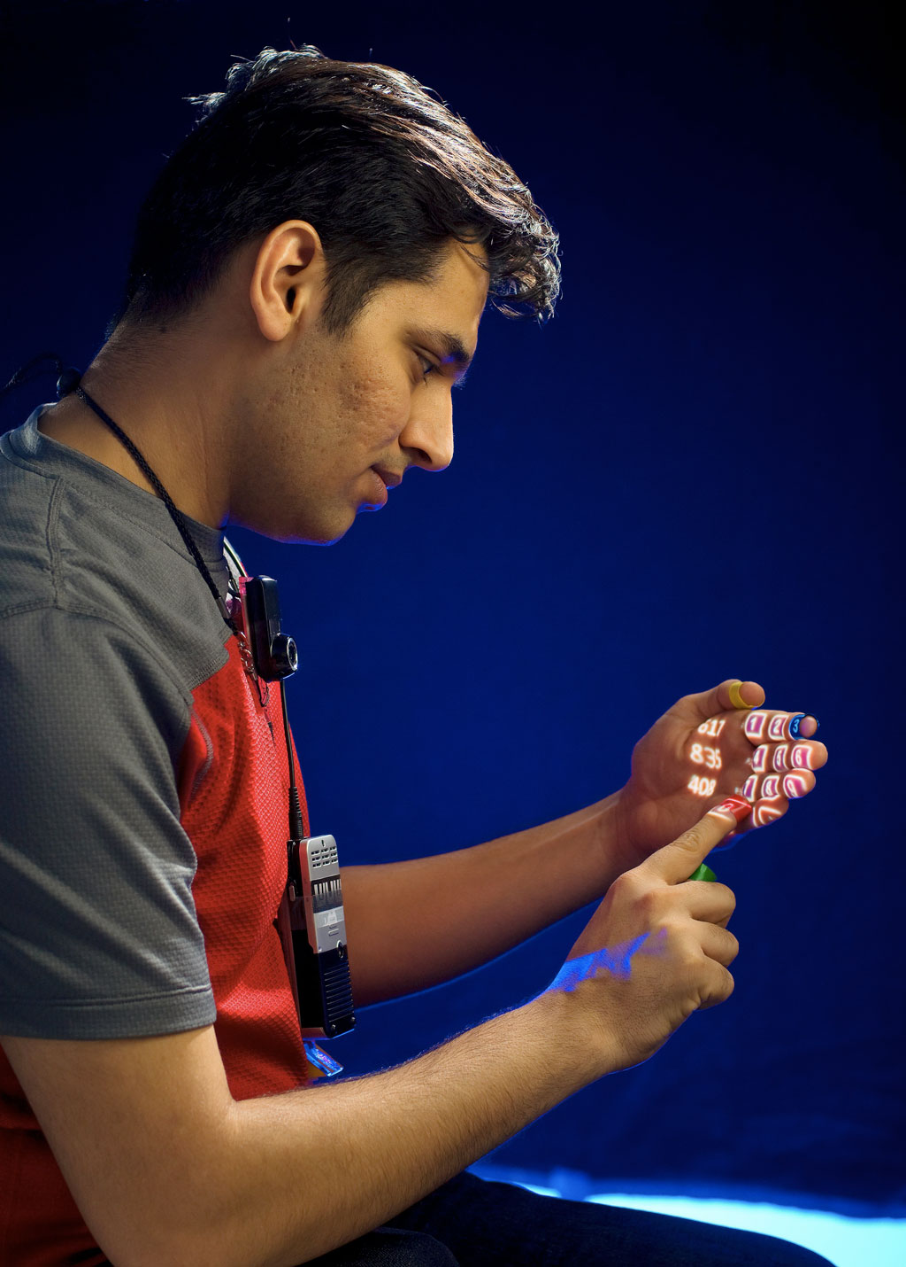
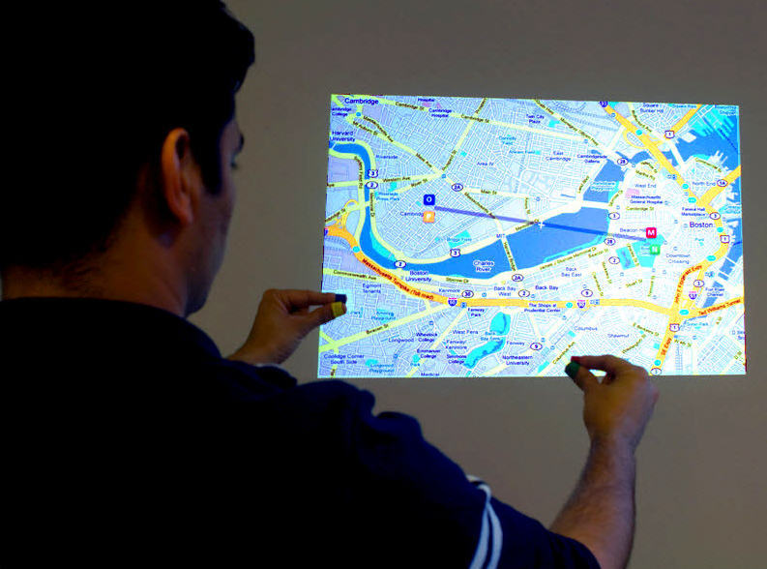
sixth sense [Mistry09]

Slide 36
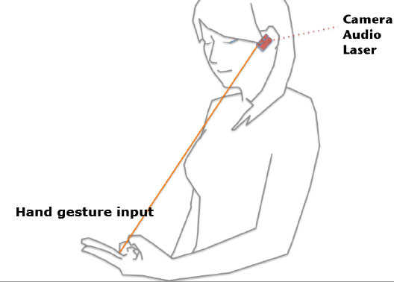
brainy hand [Rekimoto09]

Slide 37
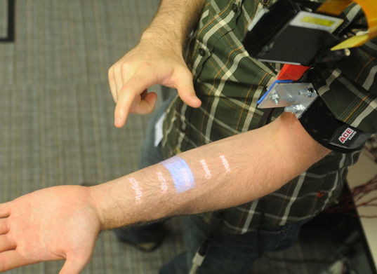
skinput [Harrison10]

Slide 38
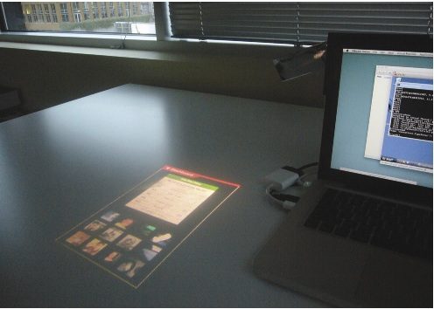
bonfire [Kane09]

Slide 39
SOMETHING DIFFERENT

Slide 40
virtual shelves [Li09]

Slide 41
USER STUDies

Slide 42
our main hypothesis:
users are able to revisit locations

Slide 43
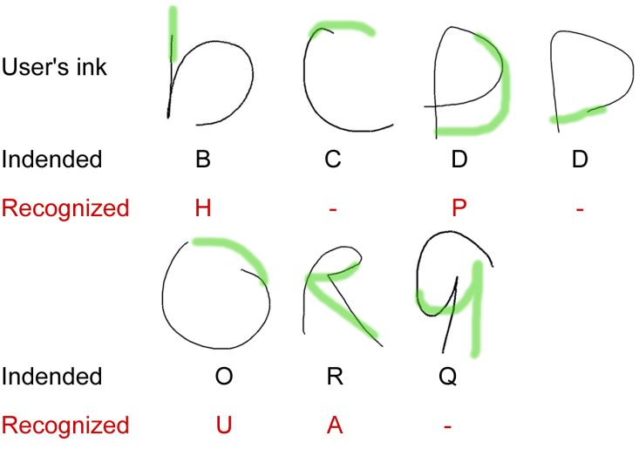
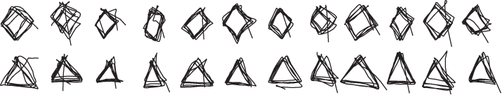
a series of studies
1a. is imaginary better than blind use?
b. how fast does the memory fade
c. compound drawings
2. when users are in motion
3. acquiring points not previously visited
1
2
3

Slide 44
USER STUDY 1 better than blind?

Slide 45
disappearing mobile [Ni and Baudisch09]

Slide 46
Study 1 – Research Q
Hypothesis:
users can return to a location, because they see their hands while interacting.

Slide 47
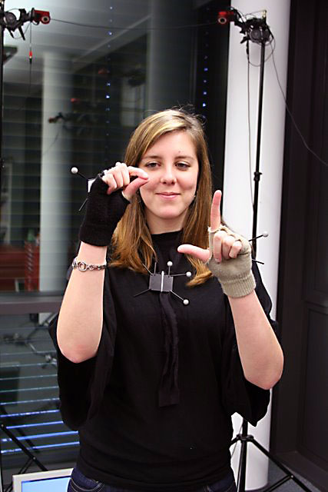
TASK 1 - GRAFITTI
CHOSEN FROM DISAPPEARING MOBILE

Slide 48
task 1 – results

Slide 49
task 1 – results

Slide 50
task 1 – results

Slide 51
TASK 2 – REPEAT DRAWING
5X

Slide 52
task 2 - RESULTS

Slide 53
TASK 3 – COMPound DRAW

Slide 54
TASK 3 - RESULTS

Slide 55
User Study 2 mobile use

Slide 56
Study 2 – Research Q
(maybe everything so far worked only because users used landmarks in the room to orient themselves)
Can people use imaginary interfaces while in motion?

Slide 57
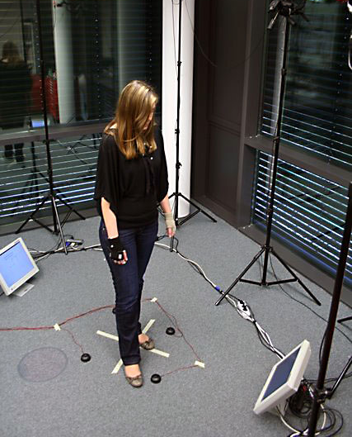
task and apparatus
1
2
3

Slide 58
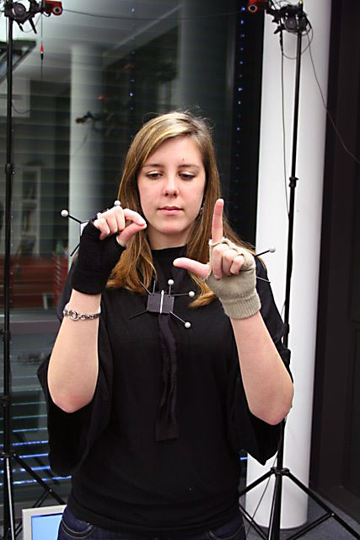
task and apparatus
select ‘1’
Draw…
then Select.

Slide 59
independent vars
Stay vs Rotate: do they rotate (move) between drawing and selecting?
Hypothesis 1:
Higher error in ‘Rotate’ condition

Slide 60
independent vars
Hand vs None: do they use the “L” gesture?
Hypothesis 2:
‘L’ gesture reduces error

Slide 61
results
error
6cm
error
4cm
2cm
0cm
stay
rotate

Slide 62
results
error
6cm
error
4cm
2cm
hand
none
hand
none
0cm
stay
rotate

Slide 63
User Study 3
Coordinates

Slide 64
Study 3 – Research Q
Can we can create addressable
locations using a coordinate
system of fingers and thumbs?

Slide 65
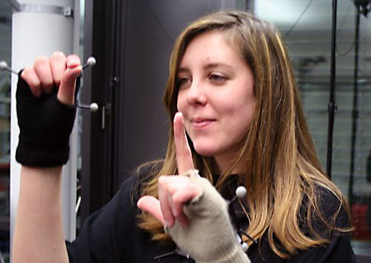
task and conditions
“2, 1”
(2,1)

Slide 66
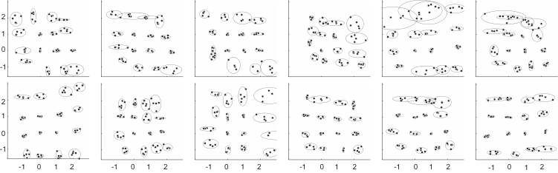
results – Raw

Slide 67

results – BUtton sizes
Button Size (finger length units)
0.8
X
Y
0.4
0.0
0
1
2
3
Manhattan distance

Slide 68
SUMMARY

Slide 69
WHAT HAVE WE LEARNED?
Visual short term memory allows users to go back to a location.
Providing a visible reference point (the L) increases performance during mobile use.
Using a finger + thumb coordinate system, system designers can create addressable locations.

Slide 70
back to the start…

Slide 71
Can people use this?
Can people
interact spatially
with something they cannot see?

Slide 72
Can people use this?
Can people
interact spatially
with something they cannot see?
YES
Imaginary != Blind

Slide 73
imaginary interfaces
Sean Gustafson
with
Daniel Bierwirth
Patrick Baudisch

