Slide 1
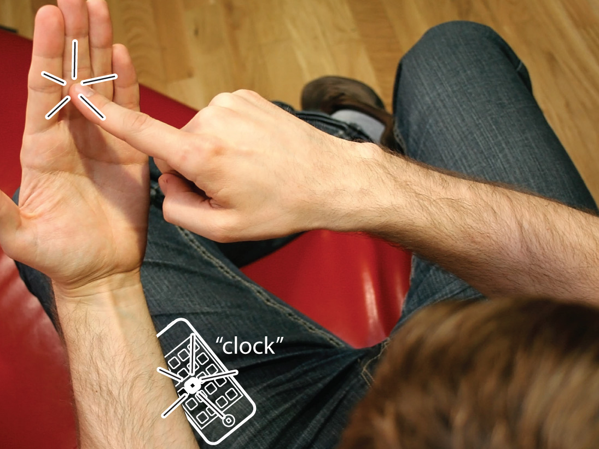

imaginary phone—
learning by transfer
sean gustafson
christian holz
patrick baudisch

Slide 2
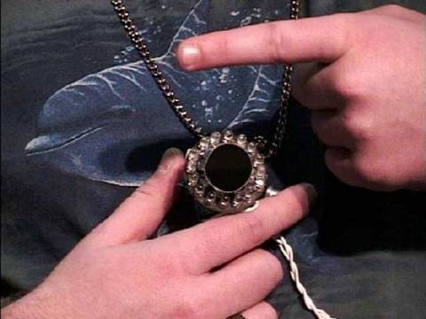
or projector
to achieve ultimate mobility: sacrifice screen
→ limited to gesture-based interaction
gesture pendant
[ISWC’00]

Slide 3
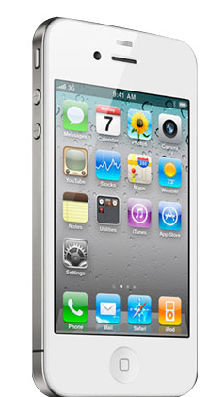
but spatial interaction (pointing) is the interaction style of current devices.

Slide 4
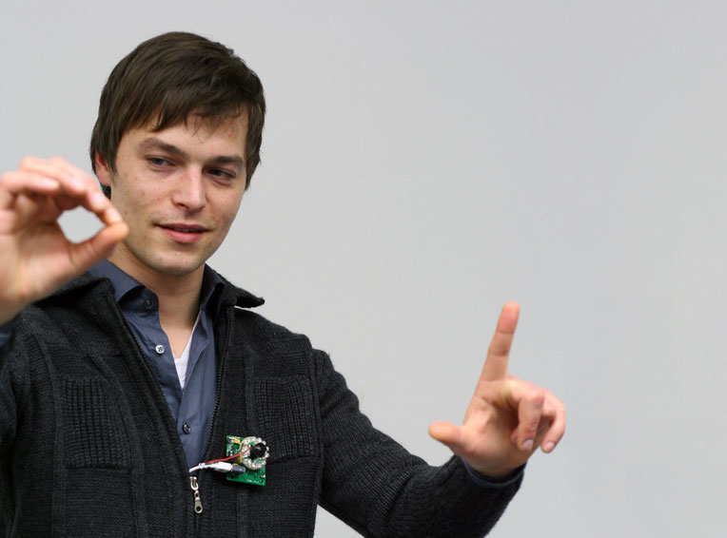
bring spatial interaction back, despite non-visual
imaginary interfaces
= “touch screen without the screen”

Slide 5
but the big problem is learning
?

Slide 6
imaginary phone

Slide 7
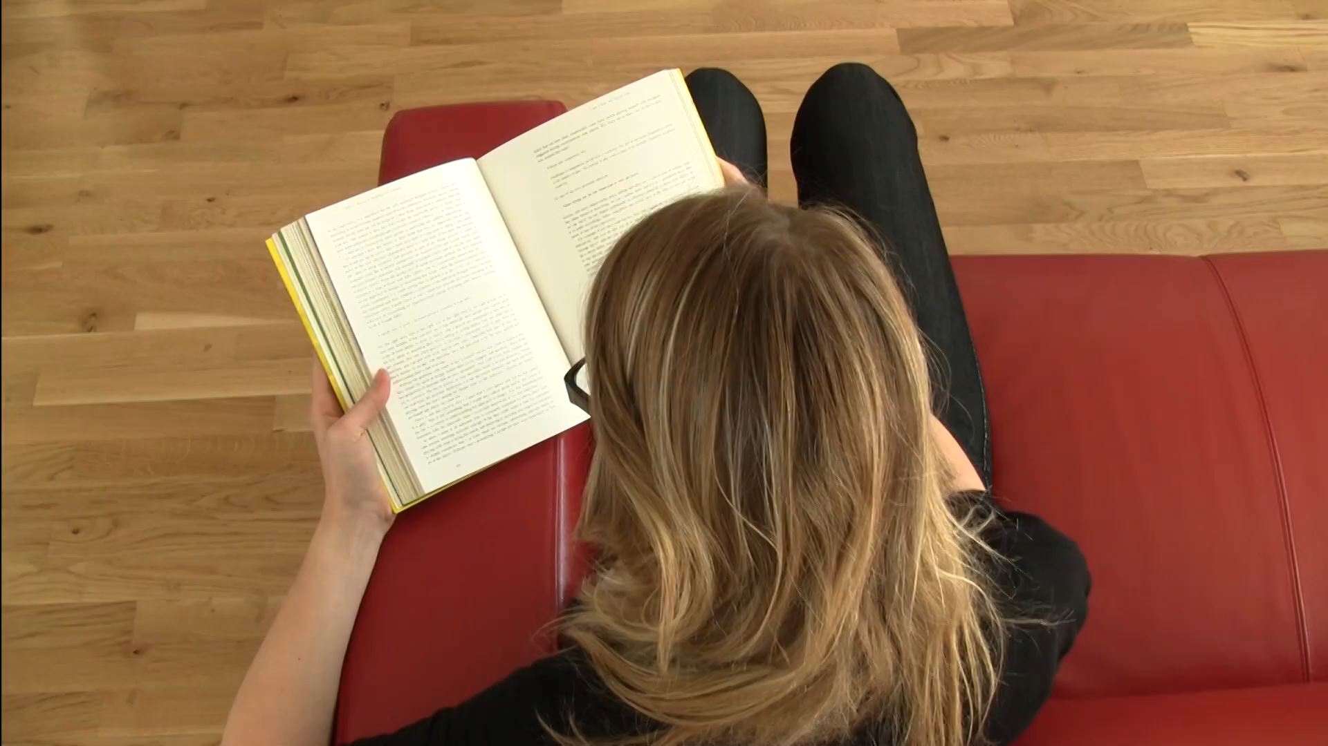

Slide 8
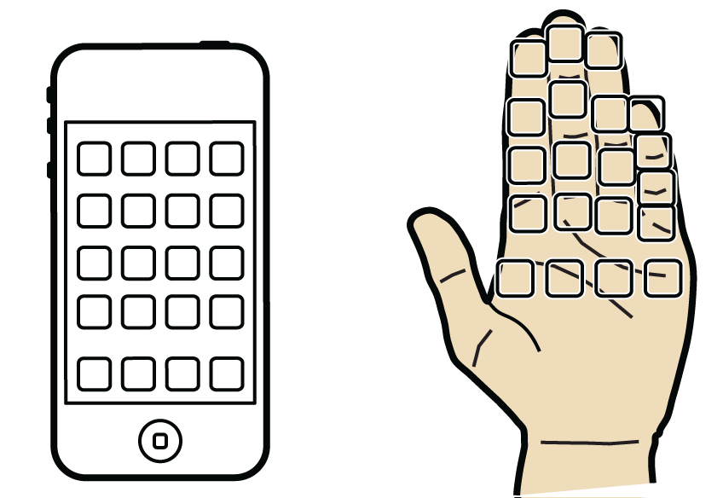

Slide 9
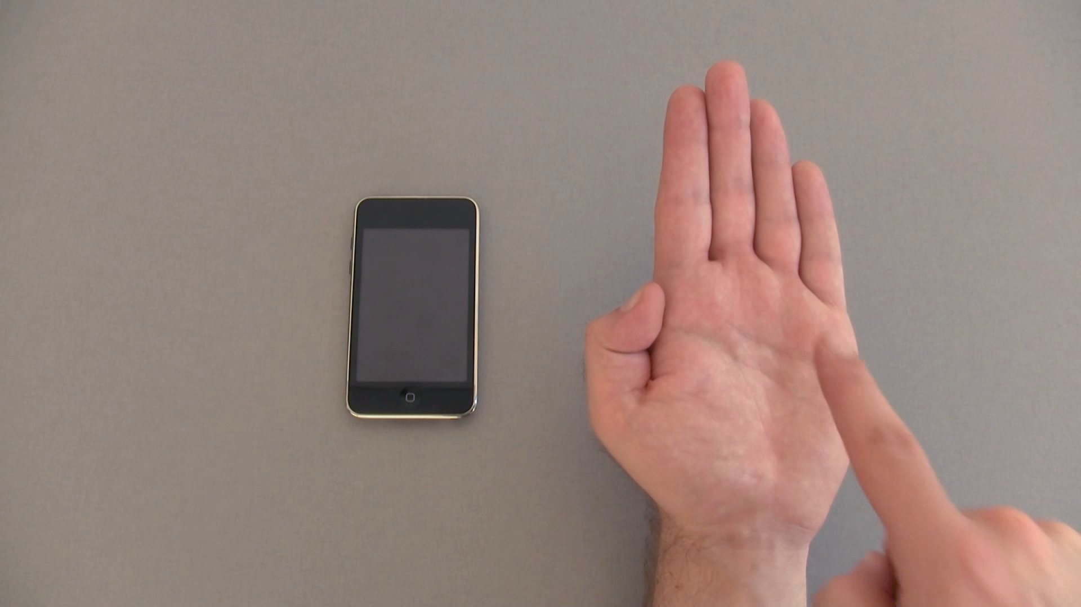

Slide 10
for this to work…

Slide 11
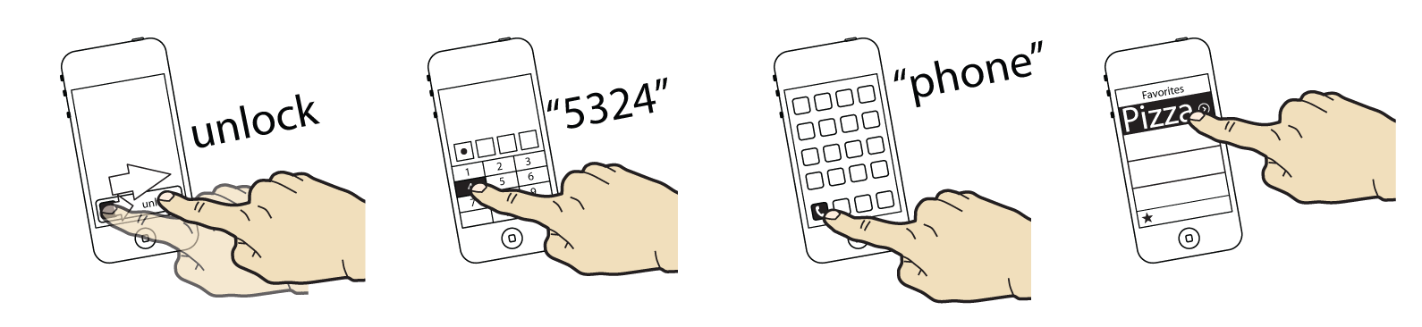
transfer learning
1. users repeatedly perform a task using
a physical device

Slide 12
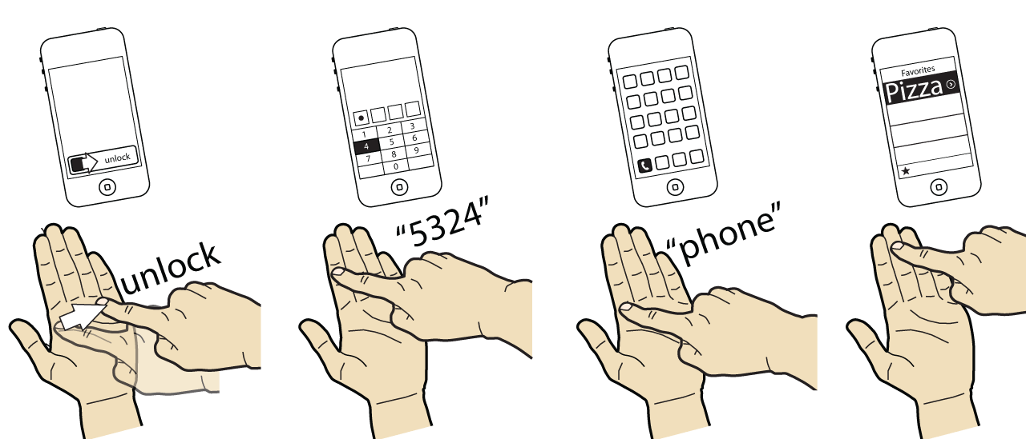
transfer learning
2. this builds up spatial memory, eventually
allows performing the task without phone

Slide 13
to make this work, we make imaginary phone
mimics the layout of the physical phone

Slide 14
imaginary phone prototype
does transfer learning work?

Slide 15
prototype

Slide 16
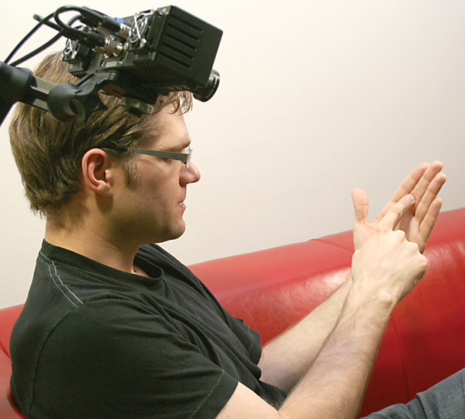

Slide 17
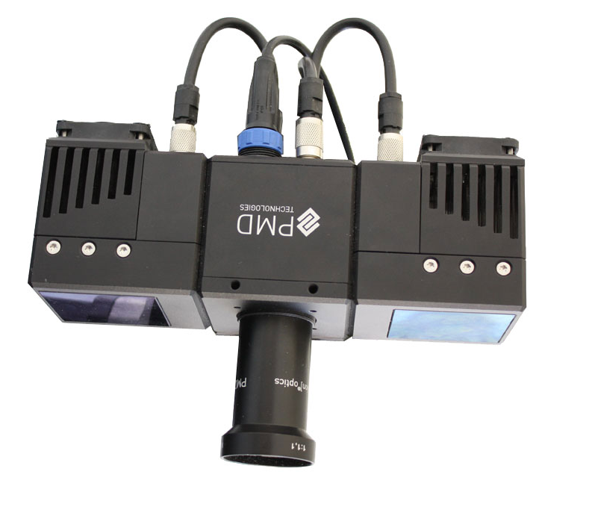
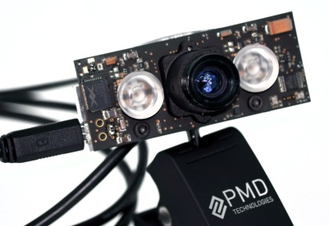
what we used
our new camera

Slide 18
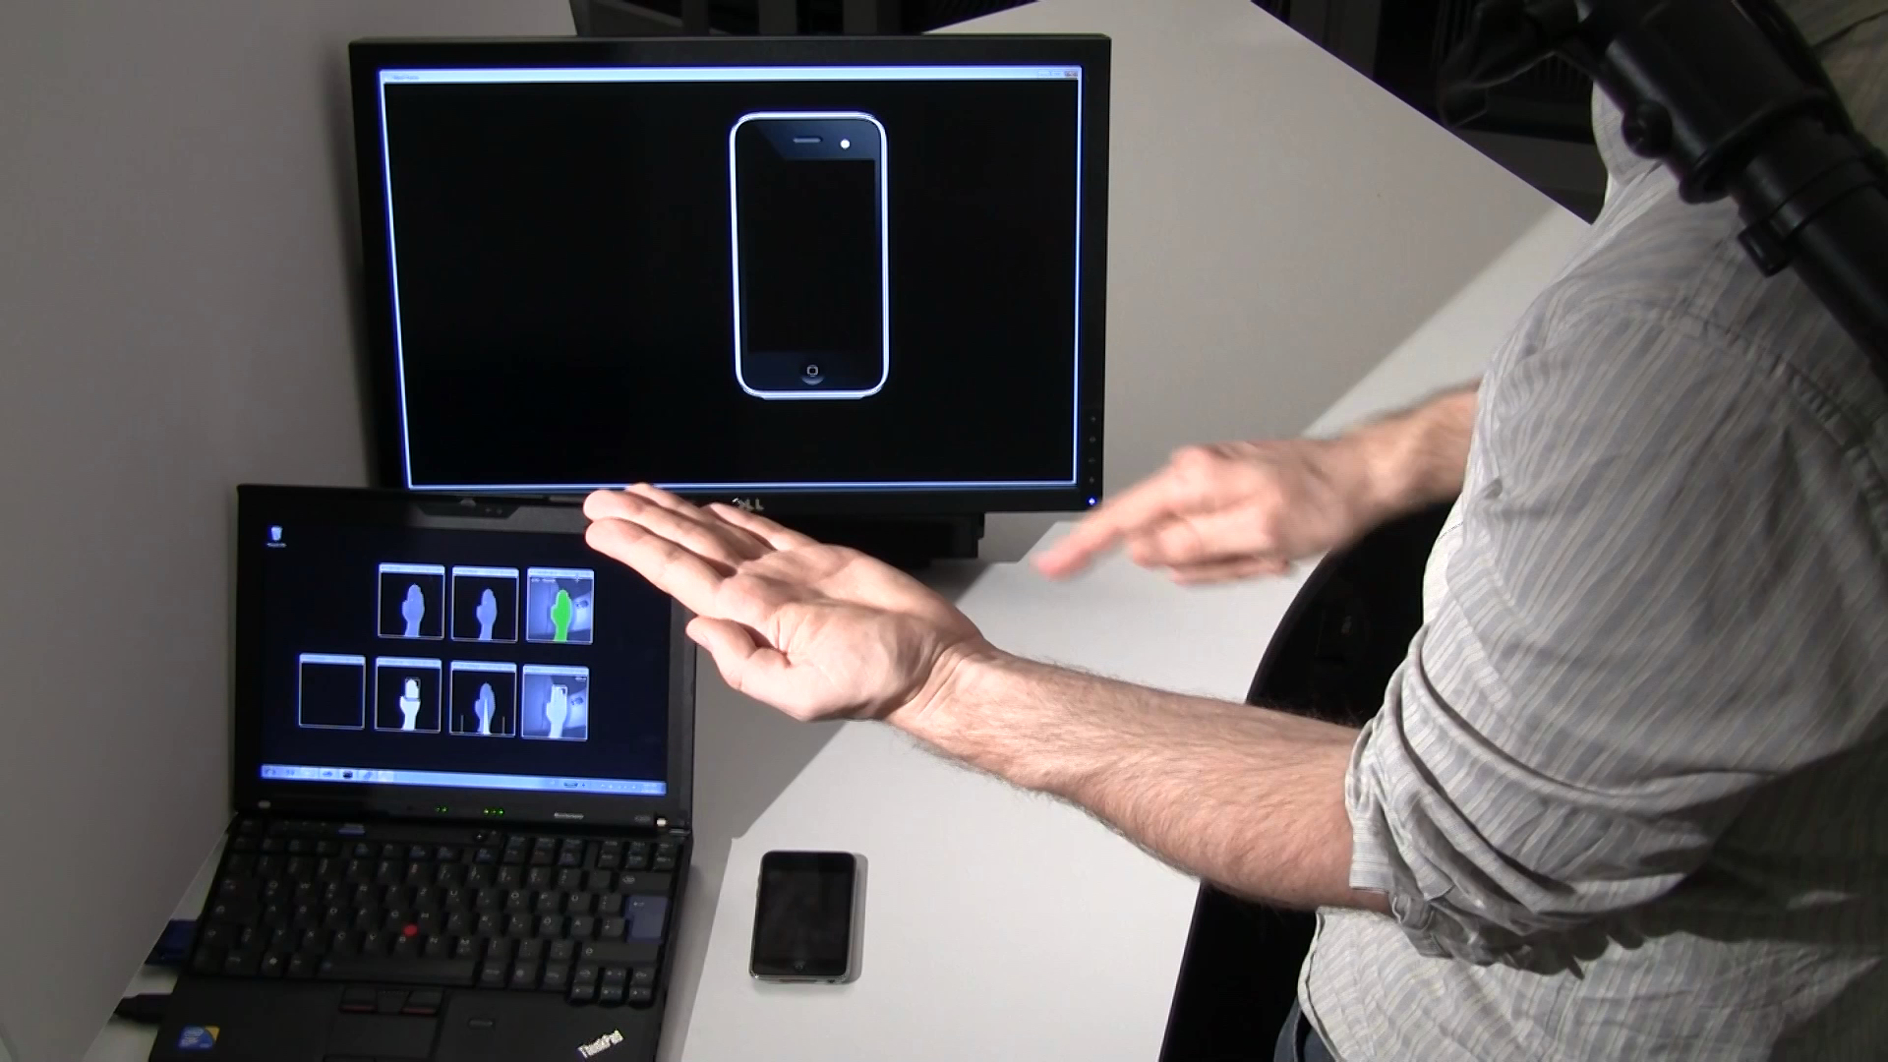

Slide 19
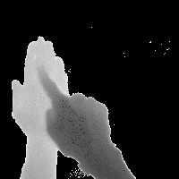

Slide 20
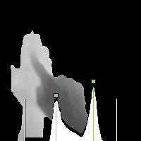

Slide 21
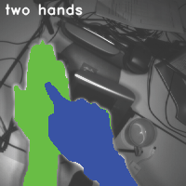

Slide 22
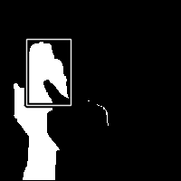

Slide 23
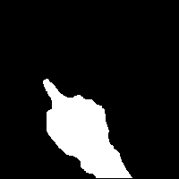

Slide 24
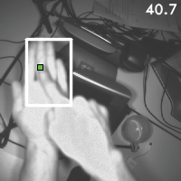

Slide 25
TUIO over WiFi

Slide 26
does transfer learning work?

Slide 27
main hypothesis:
through repeated use of a physical device
users learn how to operate the imaginary counterpart

Slide 28
learn
map
target
actually three assumptions:
1) by using the phone regularly, do users learn the layout
2) spatial knowledge is easily mapped to the hand
3) targeting on the hand is accurate enough

Slide 29
learn
map
target
with repeated use of physical phone, users build up spatial memory
spatial
memory maps to the hand
on the hand users target accurately

Slide 30
learn
map
target
1) users build up
spatial memory?

Slide 31
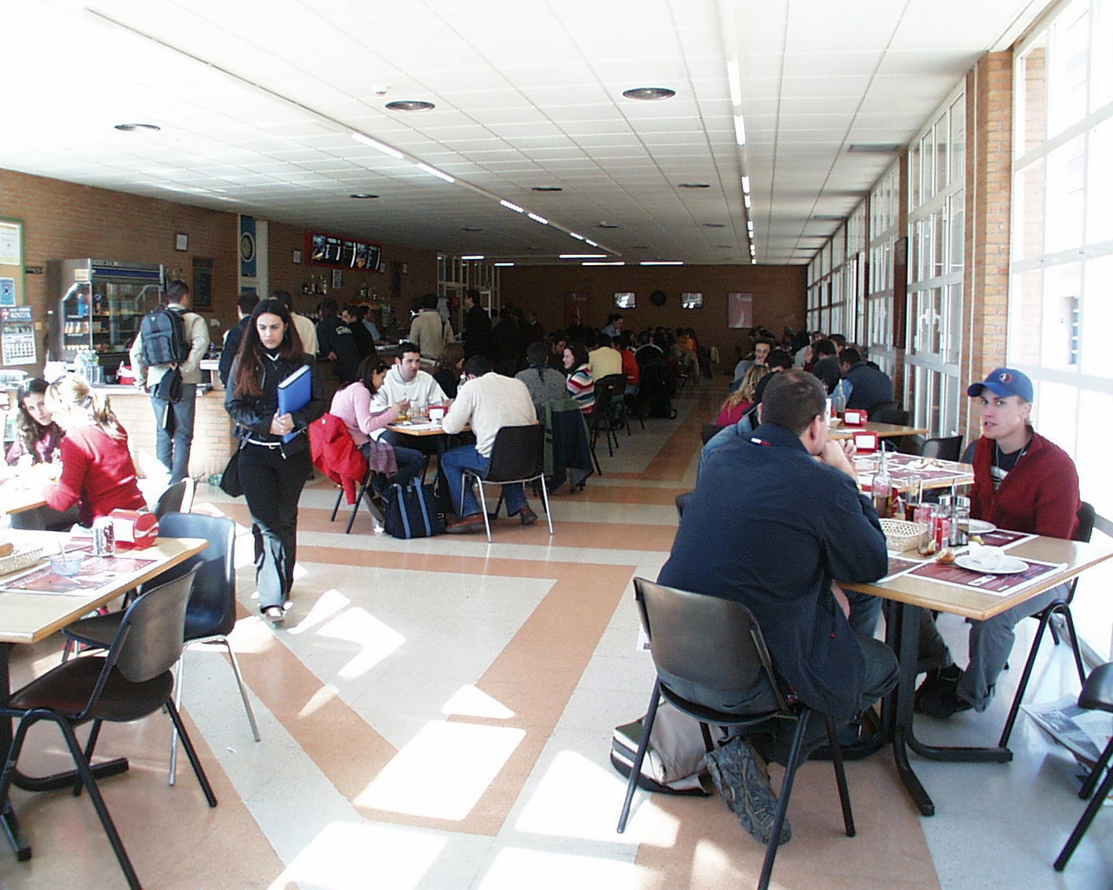
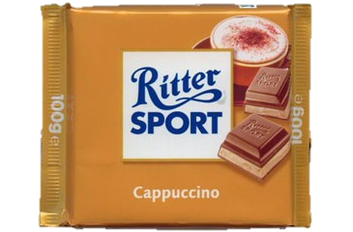
“Do you have an iPhone?
(and do you like chocolate?)”

Slide 32
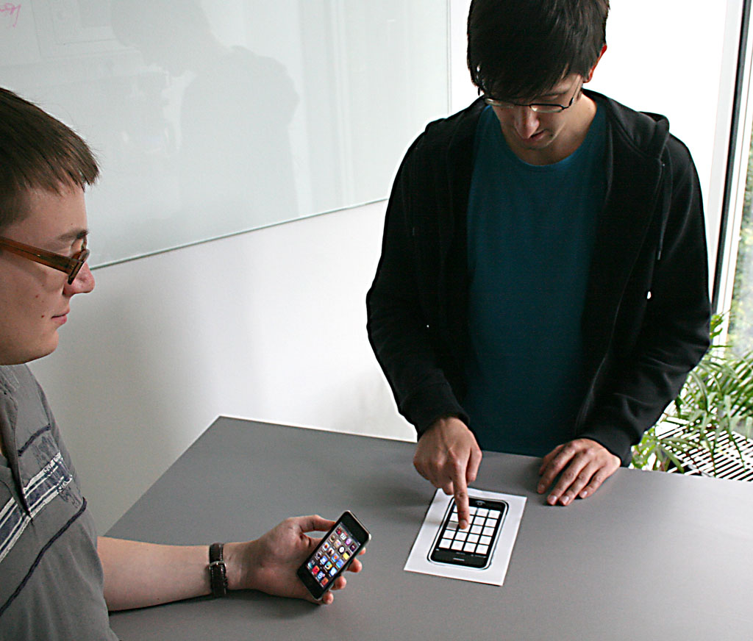
participant
experimenter

Slide 33
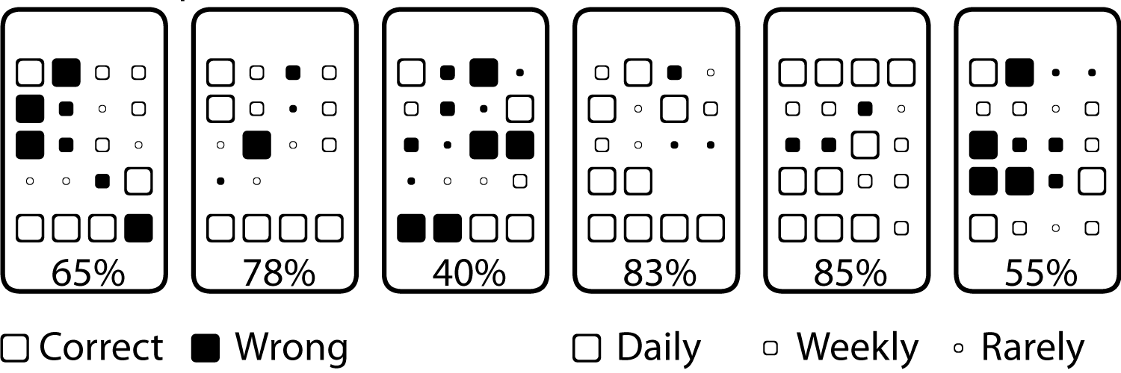

Slide 34
results
results
7
1%
%
6
7
%
6
5
%
percentage of
correctly placed apps
apps used
D
a
i
l
y
W
e
e
k
l
y
R
a
r
e
l
y

Slide 35
✔
learn
map
target
2) does spatial memory
map to the hand?

Slide 36
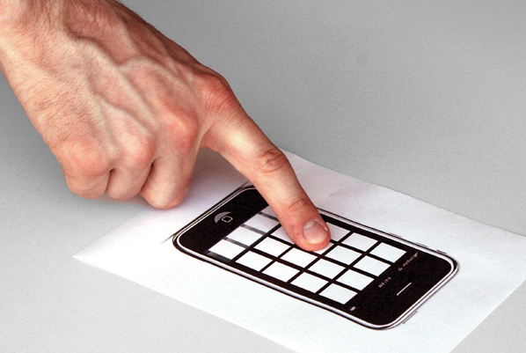
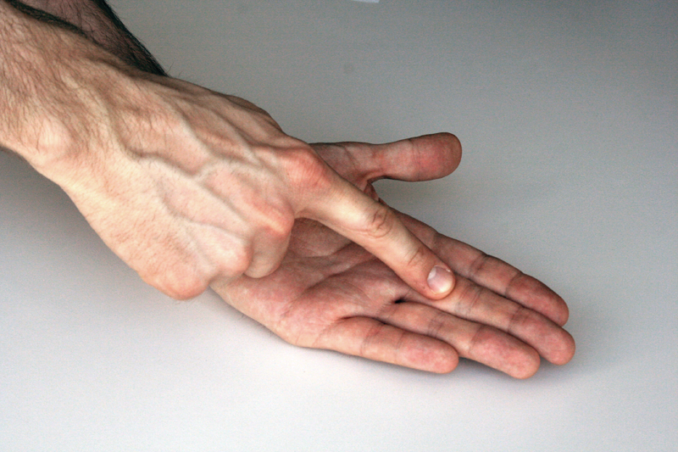
there was a second condition
select on phone prop
select on hand

Slide 37
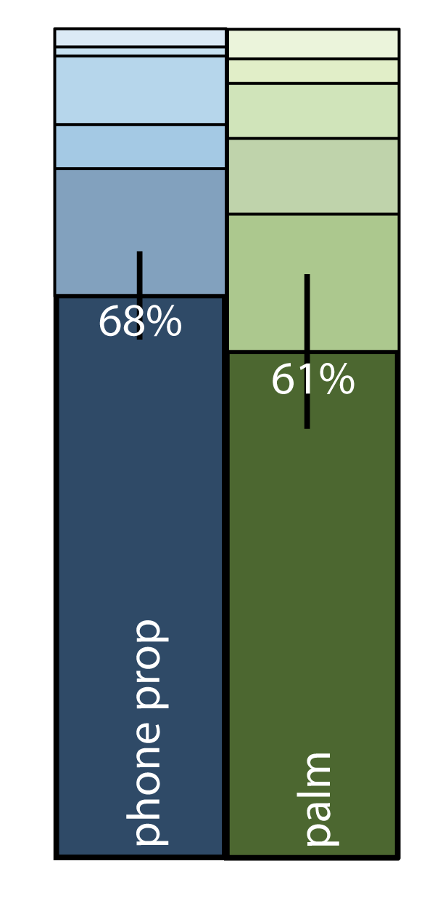
results
%
%
percentage of
correctly placed apps

Slide 38
results
%
%
percentage of
correctly placed apps

Slide 39
✔
✔
learn
map
target
3) on the hand, users target accurately?

Slide 40
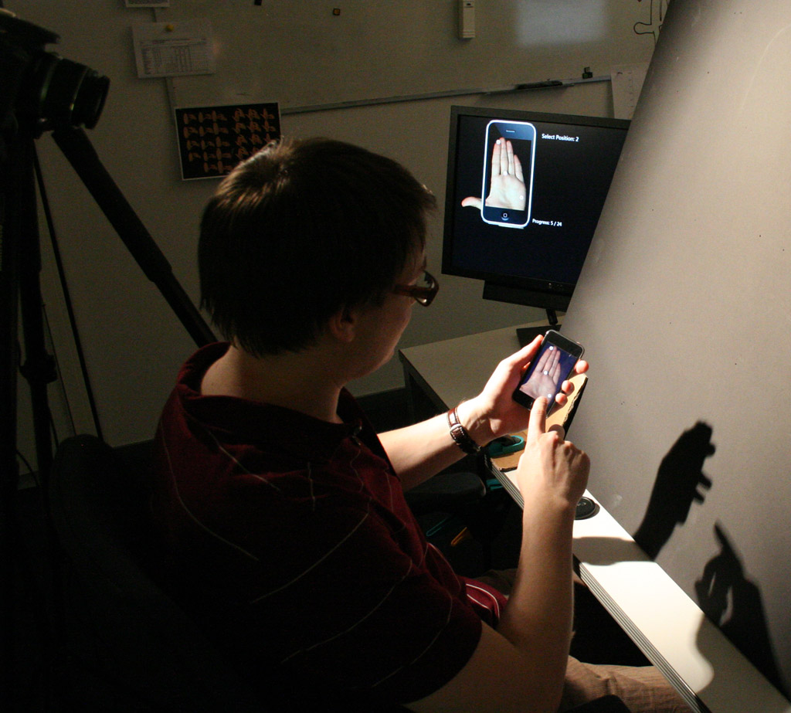

Slide 41
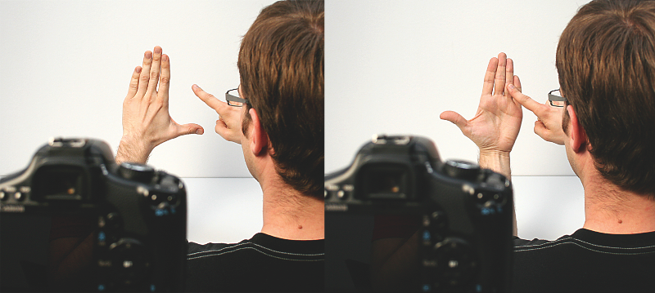
select on palm

Slide 42
select in empty space
select on palm

Slide 43
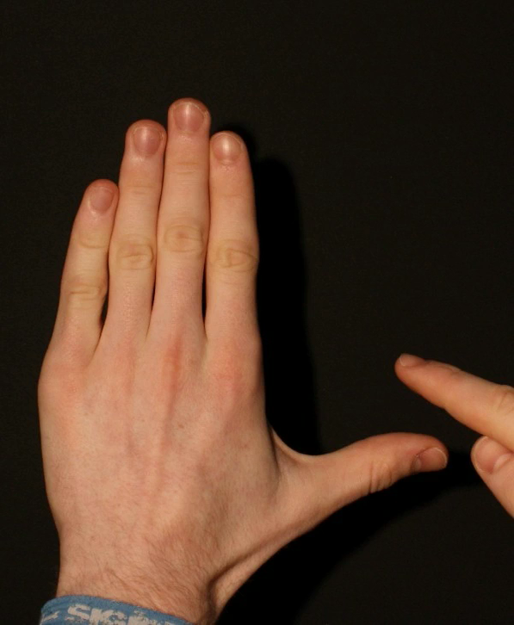

Slide 46
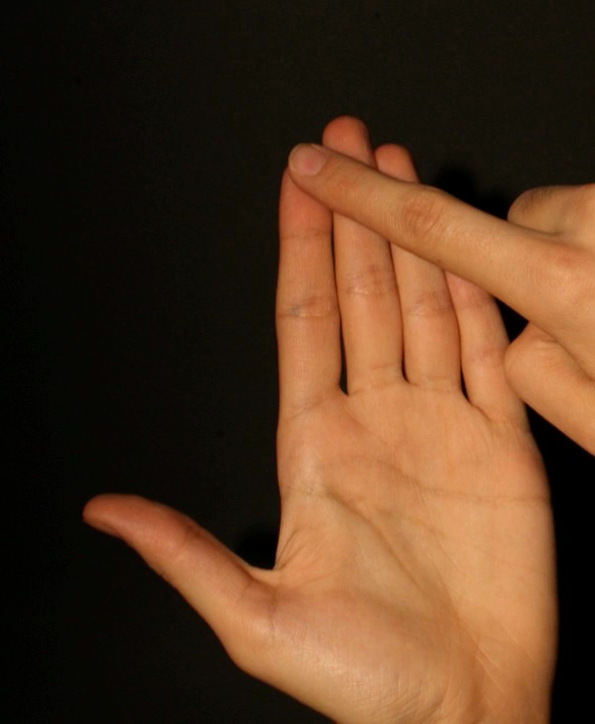

Slide 49
50%
more
accurate

Slide 50
✔
✔
✔
learn
map
target

Slide 51
if users know 70% of functions…
do we need to train them to 100%?
no, actually knowledge of a single function gets you started

Slide 53
conclusion

Slide 54
1996
2007
imaginary
:= a shortcut for mobile device

Slide 55
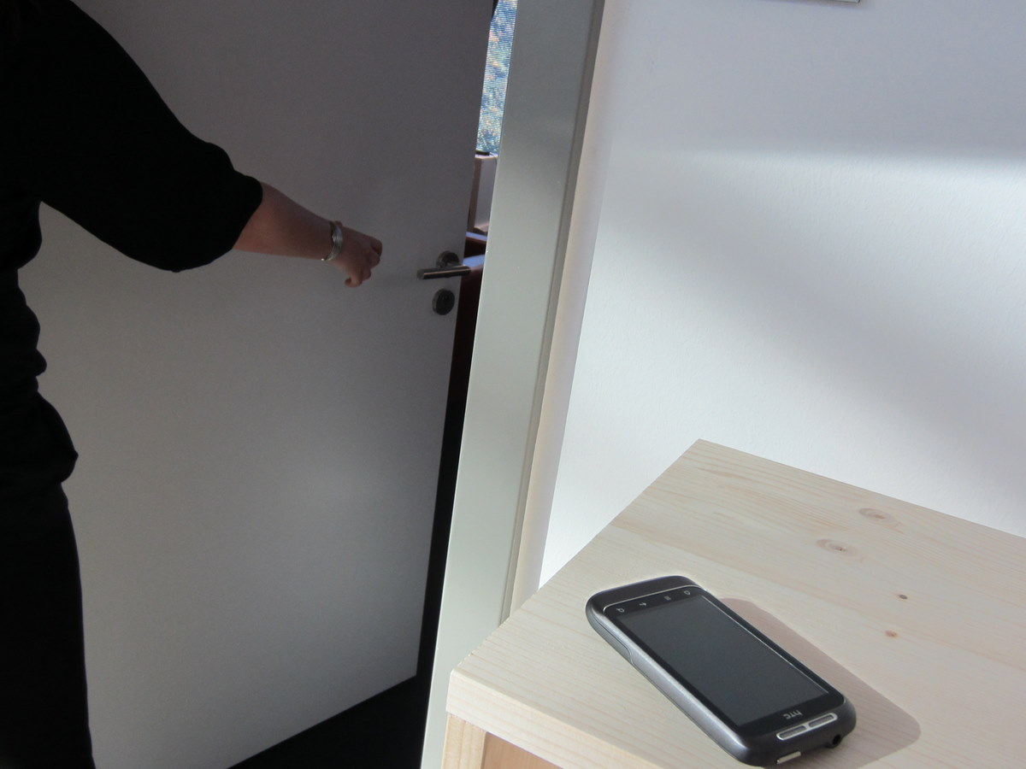
next goal: leave your phone at home
Image of phone left on counter as your walks out the door.

Slide 56
imaginary phone—
learning by transfer
sean gustafson
christian holz
patrick baudisch

